Slide 1
Correlation

Slide 2
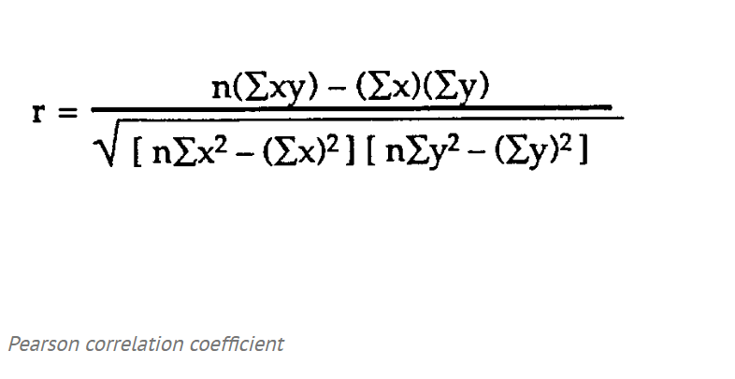

Slide 3
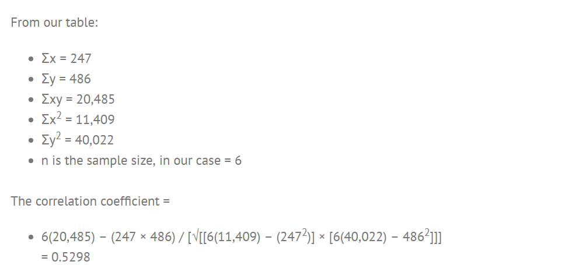

Slide 4
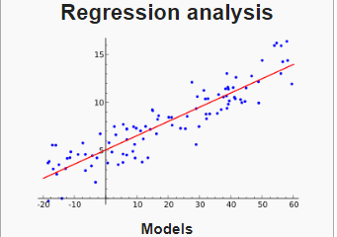

Slide 5
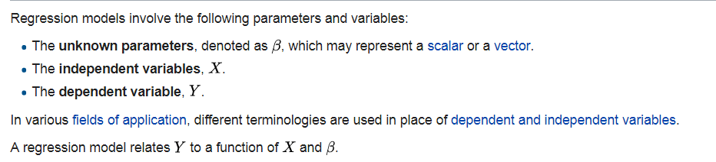

Slide 6
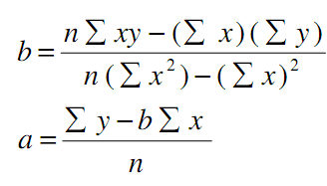

Slide 7
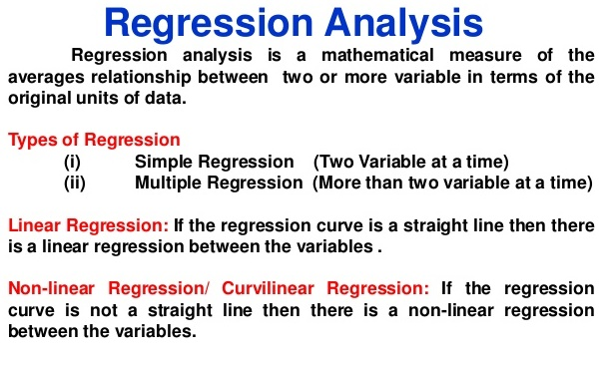

Slide 8

General linear model

Slide 9
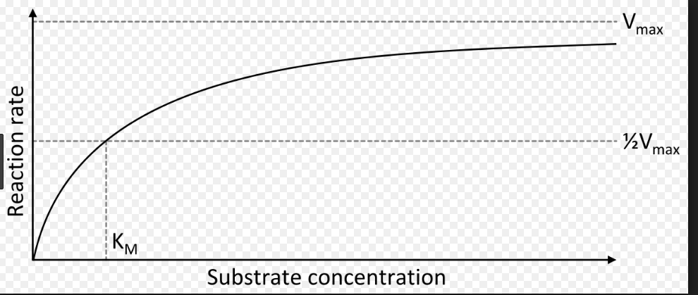
Nonlinear regression

Slide 10
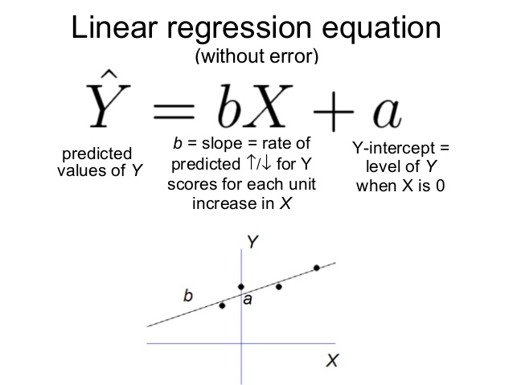

Slide 11
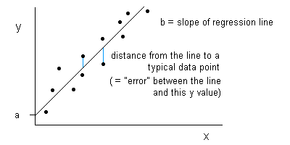

Slide 12
Simple linear
Regression analysis cannot be interpreted as a procedure for establishing a cause-and-effect relationship between variables.

Slide 13
least squares method
procedure for using sample data to find the estimated regression equation

Slide 14
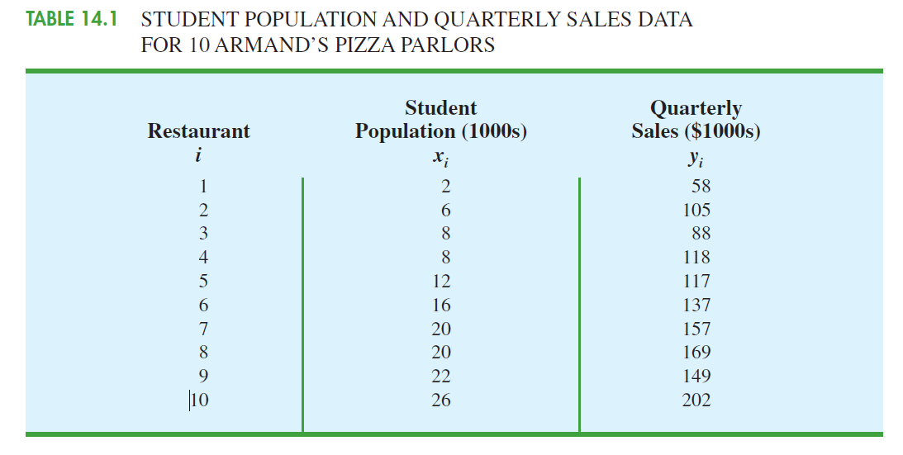

Slide 15
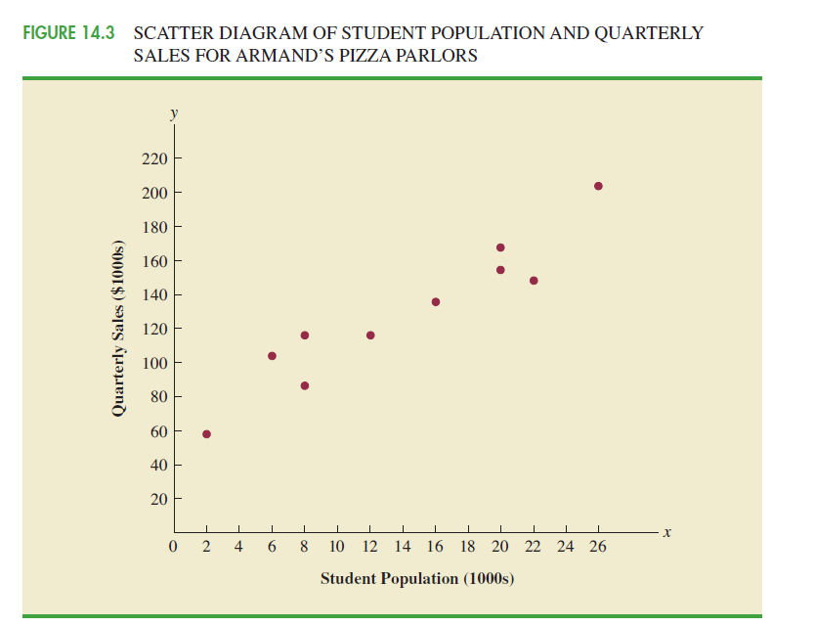

Slide 16
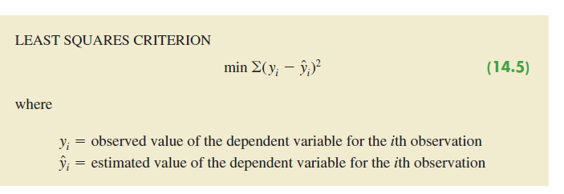

Slide 17
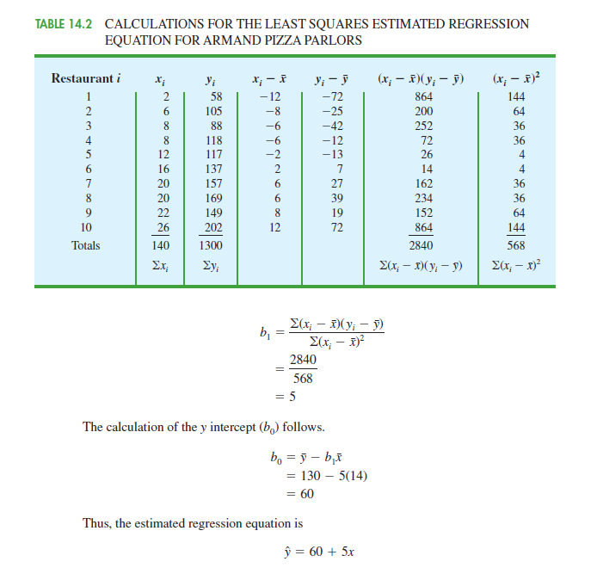

Slide 18
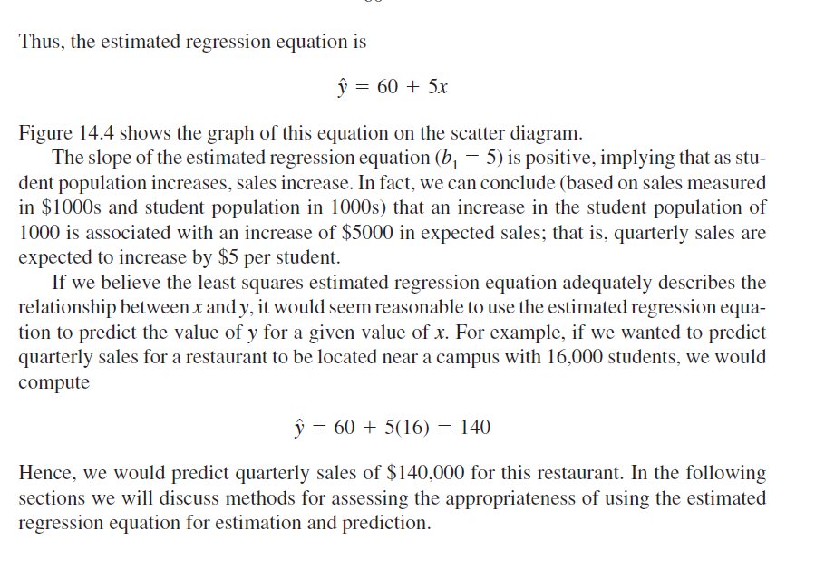

Slide 19
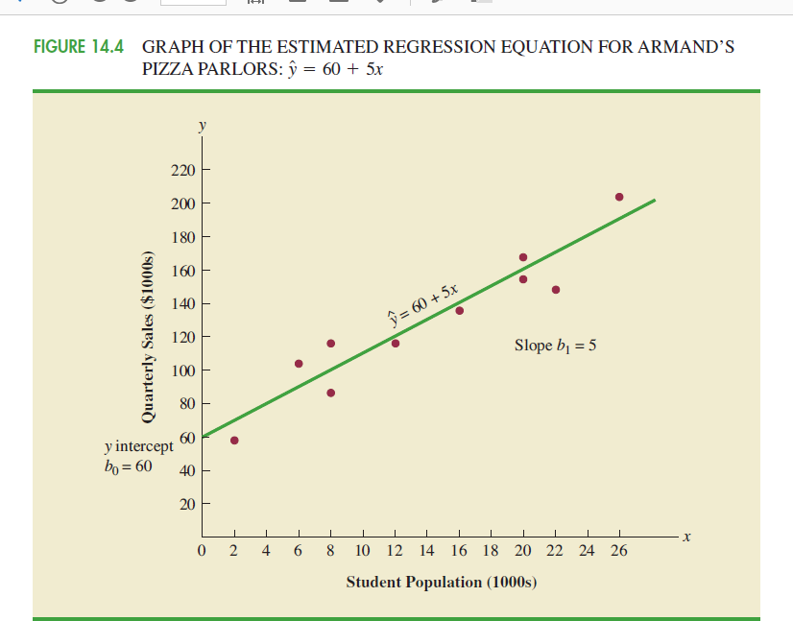

Slide 20
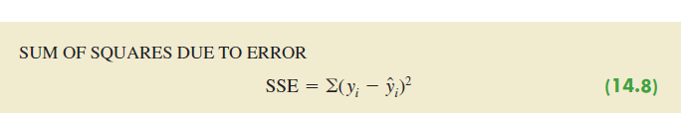
coefficient of determination

Slide 21
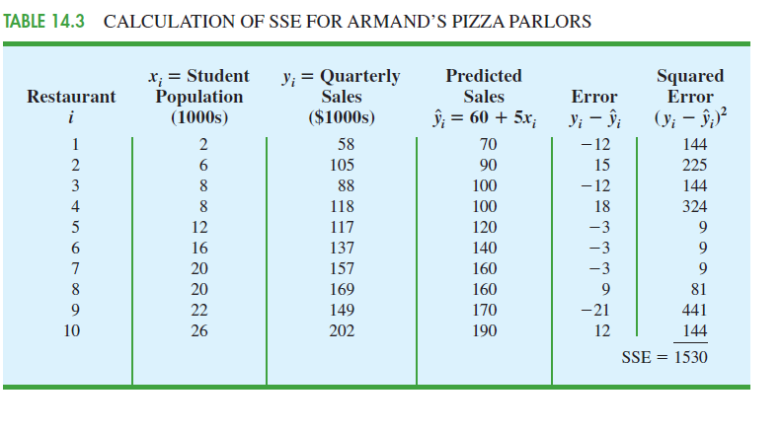

Slide 22

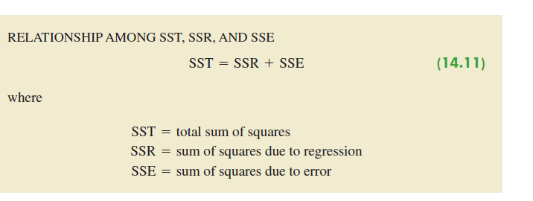

Slide 23
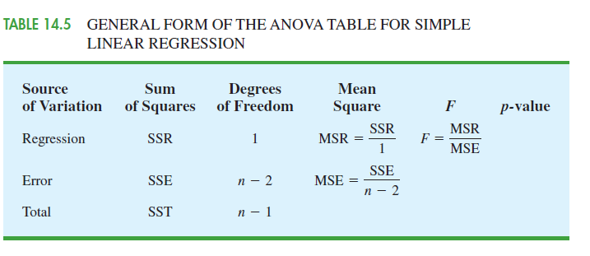

Slide 24
Point Estimation
Interval Estimation
Thus, with 110 and a margin of error of tα/2s yˆp
yˆp
2.306(4.95) 11.415, the 95% confidence interval estimate is
110 +/- 11.415

Slide 25
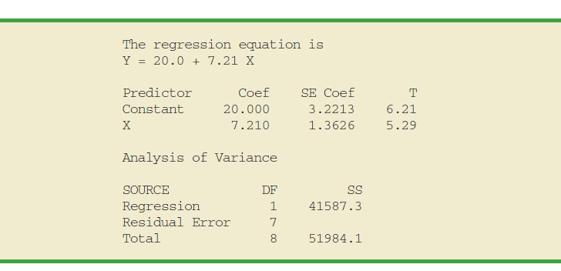

Slide 26
residual for observation

Slide 27
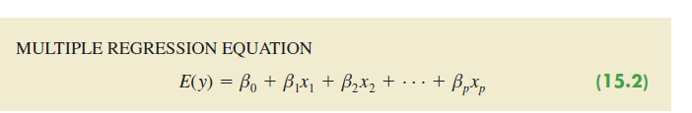
Multiple Regression

Slide 28
categorical independent variables such as gender (male, female), method of payment (cash, credit card, check),

Slide 29
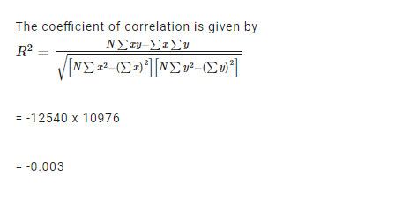
R squared

Slide 30
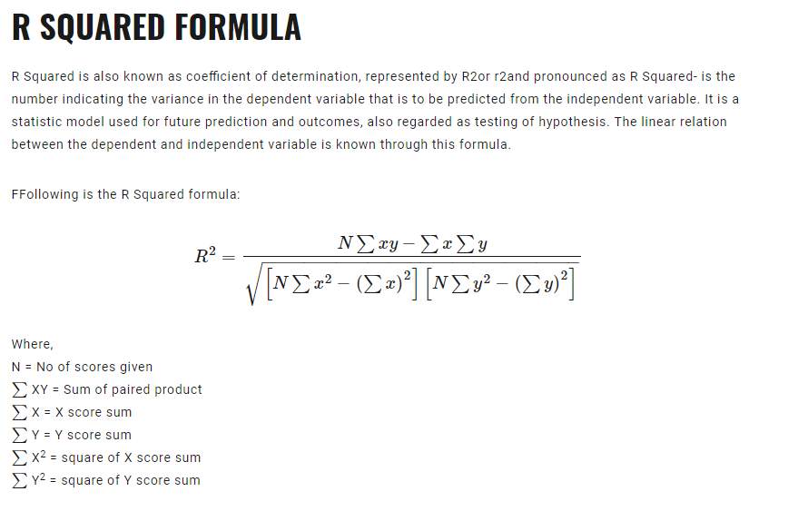

Slide 31
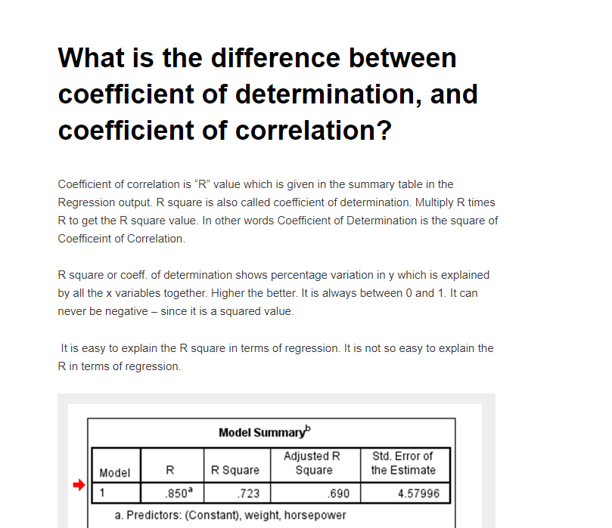

Slide 32
R Square is a basic matrix which tells you about that how much variance is been explained by the model.
What adjusted R square do is calculate R square from only those variables whose addition in the model which are significant
if R-square is 0.8, it means 80% of the variation in the output variable is explained by the input variables. So, in simple terms, higher the R squared, the more variation is explained by your input variables and hence better is your model.

Slide 33
The standard error of the regression provides the absolute measure of the typical distance that the data points fall from the regression line. S is in the units of the dependent variable.

Slide 34
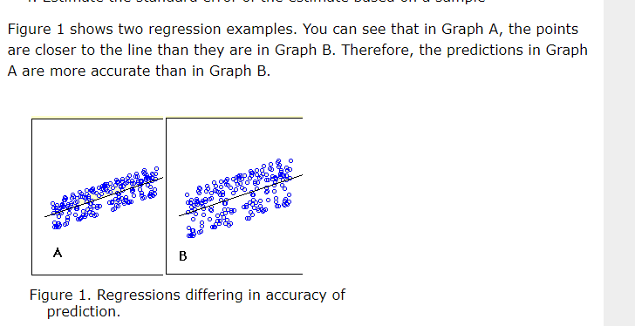
Standard Error of the Estimate

Slide 35
The standard error of the estimate is a measure of the accuracy of predictions. The regression line is the line that minimizes the sum of squared deviations of prediction (also called the sum of squares error), and the standard error of the estimate is the square root of the average squared deviation.
Smaller the standard error of the estimate is, the more accurate the predictions are.

Slide 36
These are the “Goodness of Fit” measures. They tell you how well the calculated linear regression equation fits your data.
Multiple R. This is the correlation coefficient. It tells you how strong the linear relationship is. For example, a value of 1 means a perfect positive relationship and a value of zero means no relationship at all. It is the square root of r squared (see #2).
R squared. This is r², the Coefficient of Determination. It tells you how many points fall on the regression line. for example, 80% means that 80% of the variation of y-values around the mean are explained by the x-values. In other words, 80% of the values fit the model.
Adjusted R square. The adjusted R-square adjusts for the number of terms in a model. You’ll want to use this instead of #2 if you have more than one x variable.
Standard Error of the regression: An estimate of the standard deviation of the error μ. This is not the same as the standard error in descriptive statistics! The standard error of the regression is the precision that the regression coefficient is measured; if the coefficient is large compared to the standard error, then the coefficient is probably different from 0.
Observations. Number of observations in the sample.

